Slide 1
An introduction to Web Engineering
Chapter -1

Slide 2

Why web engineering?
From info medium to Application medium
Web applications today are full-fledged, complex software systems
Technologies and standards are used as a development platform and as a user platform at the same time
Notes:
Web services, are not Web applications, but they can be part of one
Web sites without software components, such as static HTML pages, are not Web applications either

Slide 4
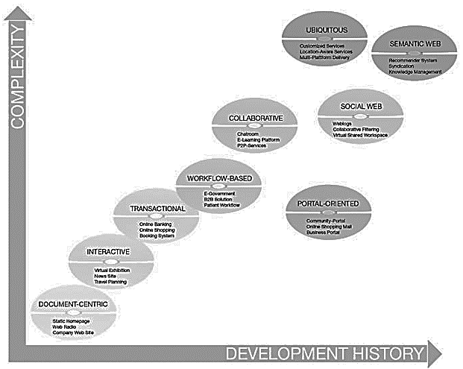
Categories of Web Applications
Document centric
Interactive
Transactional
Workflow-based
Collaborative
Social Web
Portal-oriented
Ubiquitous
Semantic Web
Notes:
Workflow-based applications are transaction-based
the higher level of development requires the previous development of a less complex category.
Exception : Some of the categories (e.g. the portal-oriented applications) are historically rather recent while having a lower degree of complexity
Web application can be started in any of these categories and later expanded to increasing degrees of complexity
Newer categories are generally more complex, but this does not mean they can fully replace the older generation.
Web applications can typically be assigned to several categories at once

Slide 5
Document centric Web application
precursor to Web applications
stored on a Web server as static HTML docs and sent to the Web client in response to a request
updated manually
often results in outdated information
Danger of inconsistencies
simplicity and stability
Short response time
Example:
Static homepages, simple web presences for small businesses belong in this category.
Notes:
Web sites requiring frequent changes or for sites with huge numbers of pages this is a significant cost factor and often results in outdated information. Additionally
Danger of inconsistencies : some content is frequently represented redundantly on several Web pages
for easy acces
Short response time : the pages are already stored on the Web server.
Example : Static homepages, webcasts, and simple web presences for small businesses belong in this category.

Slide 6
Interactive Web application
CGI (Common Gateway Interface) and HTML forms based
Dynamically generated Web pages and links
Example:
virtual exhibitions,
news sites,
timetable information.
Notes:
Web applications emerged, offering a first, simple, form of interactivity by means of forms, radio buttons and selection menus.
Web pages and links to other pages are generated dynamically according to user input

Slide 7
Transactional Web application
more interactivity
Data Driven
Allow info. update by user
efficient and consistent handling of the increasing amount of content
Example:
Online banking,
online shopping
booking systems
Hotel website+room booking system
Notes:
more interactivity : not only interacting with the application in a read-only manner, but also by performing updates on the underlying content.
Data Driven : prerequisite for this are database systems

Slide 8
Workflow-based Web application
handling of workflows within or between different entities
Interoperability
require a certain structuring of the automated processes and operations
Challenges:
complexity of the services
the autonomy of the participating companies
robust and flexible workflow
Example:
B2B solutions in e-commerce
e-government applications in the area of public administration
Web-based support of patient workflows in the health sector.
Notes:
handling of workflows : companies, public authorities, and private users
Interoperability : A driving force for this is the availability of appropriate Web services to guarantee interoperability
Challenges : The complexity of the services in question, the autonomy of the participating companies and the necessity for the workflows to be robust and flexible are the main challenges

Slide 9
Collaborative Web application
Groupware
High degree of communication between the co-operating entities
support shared information and workspaces
Example:
Wiki
Google meet
E-learning platforms (google classroom)
Scheduling systems
Notes:
groupware employed especially for co-operation purposes in unstructured operations
support shared information and workspaces in order to generate, edit, and manage shared information
They are also used to keep logs of many small entries and edits (as in Weblogs), to mediate meetings or make decisions

Slide 10
Social Web application
Find Related objects of interest
Find people with similar interests
people provide their identity to a community of others with similar interests
Example:
blogs
Friendster
Facebook
Quora

Slide 11
Portal-oriented Web application
Central hubs to access web
Provides single point of access to separate, potentially heterogeneous sources of information
specialized portals
business portals
marketplace portals
community portals
Notes:
Business portals give employees and/or business partners focused access to different sources of information and services through an intranet or extranet.
Marketplace portals are divided into horizontal and vertical market places.
Horizontal marketplaces operate on the b2c and b2b selling their products to companies from other sectors.
Vertical marketplaces: companies from a single sector, suppliers on one side and manufacturing companies on the other
Community portals are directed at specific target groups (young people) try to create customer loyalty through
user interaction or to provide individual offers through appropriate user management (one-to-one
marketing).

Slide 12
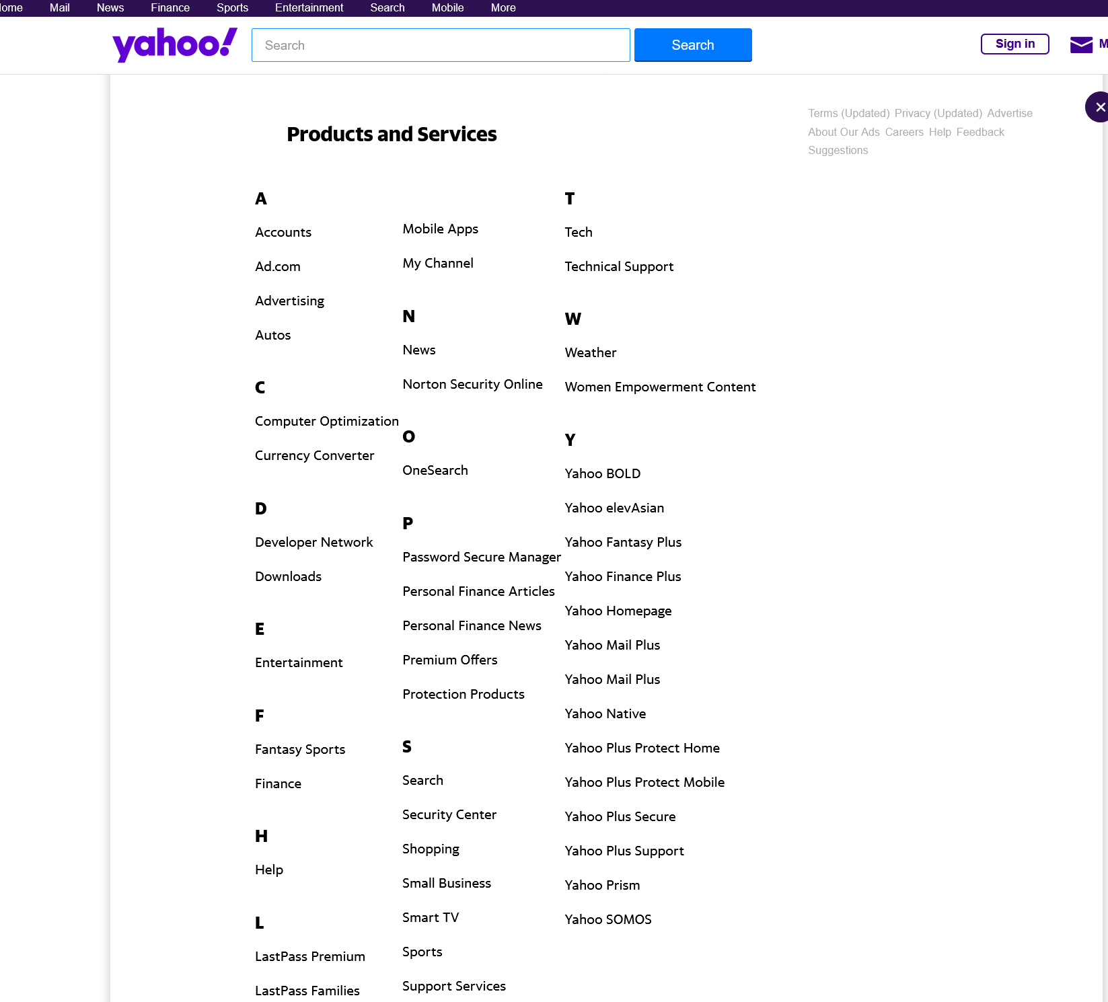
Yahoo!

Slide 13
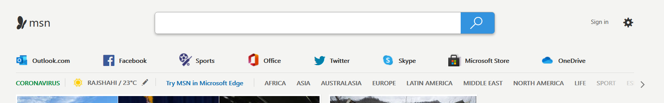
MSN

Slide 14
Ubiquitous Web application
Customized services anytime anywhere and for any device
personalization (dynamic adjustments according to the users’ situation )
location-aware services
Limitations:
Limitations Of Mobile devices
The context
Notes:
An example
of this would be displaying the menu of the day on the mobile devices of all users entering a
restaurant between 11 am and 2 pm
For this type of system it is important to take into account the limitations of mobile devices (bandwidth, screen size, memory, immaturity of software, etc.) and the context in which the Web application is currently being used. Based on this dynamic adjustments according to the users’ situation can be made
near future where ubiquitous applications will dominate the market.

Slide 15
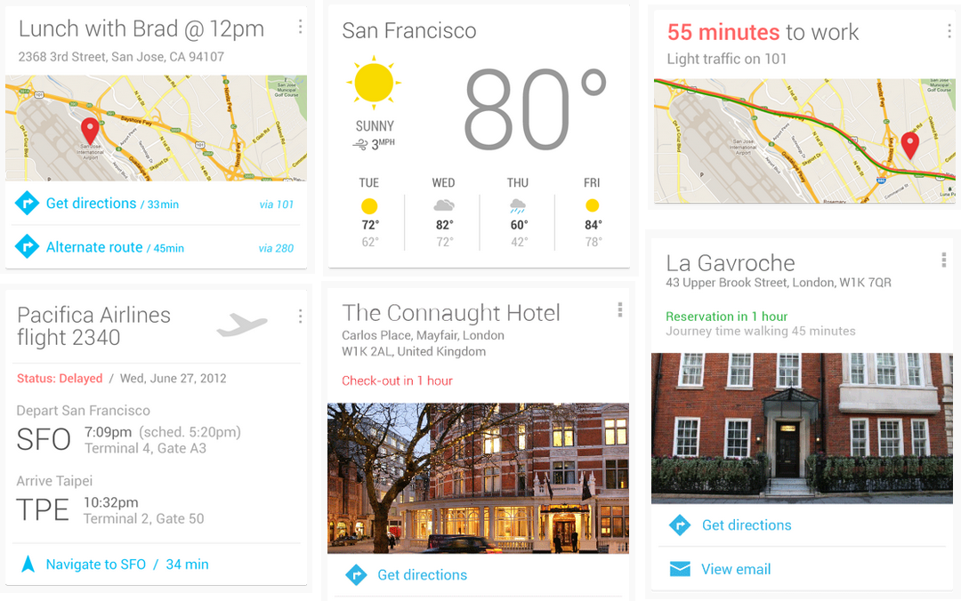
Example of Ubiquitous Web App (Google Now)

Slide 16
Semantic Web application
Presenting information on the Web not only for humans, but also in a machine-readable form
Facilitate knowledge management on the Web
Content syndication
Locating new relevant knowledge, e.g. by means of recommender systems
Supports more ubiquitous
SELECT
price, spec, photo
FROM
Internet
WHERE
product_name LIKE ‘iphone’
Notes:
The goal of the Semantic Web is to present information on the Web not merely for humans, but also in a machine-readable form

Slide 17
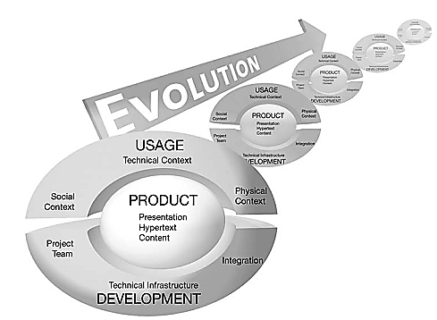
Characteristics of Web Applications
Web applications differ from traditional, non-Web-based applications in a variety of features worth looking into
Characteristics and arranged along 4 dimensions
Product
Usage
Development
Evolution

Slide 18
Characteristics of Web Applications
Product-related Characteristics
Content
hypertextual structure (navigational structure)
presentation (the user interface)

Slide 19
Product-related Characteristics
Content
Content is equally important as the Web application
Web application developers : programmers and authors
provided as tables, text, graphics, animations, audio, or video
Targeted to certain user groups
Content Quality
Update frequency
exact, consistent and reliable

Slide 20
Product-related Characteristics
Hyper-text
a basis for the structuring and presentation of information
Non linear
Basic elements
Nodes : uniquely identifiable info unit
Links : path form one node to another
Anchor :
Problem:
Disorientation: lose ones focus while browsing
cognitive overload : overwhelmed by the amount of info

Slide 21
Product-related Characteristics
Presentation
Two special features of Web applications at the presentation level
Aesthetics
Look-and-feel
Visual presentation of web pages
often determines success or failure
self-explanation
should be possible to use without documentation.
interaction behavior must be consistent

Slide 22
User-related Characteristics
Heterogeneous usages
Users vary in numbers and cultural background
devices have differing hardware and software characteristics
The usage of Web applications is characterized by the necessity to continuously adapt to specific usage situations, so-called contexts

Slide 23
User-related Characteristics
Social Context: Users
Technical Context: Network and Devices
Natural Context: Location and Time

Slide 24
Social Context: Users
Spontaneity:
user cannot be expected to be loyal
users will only use if it appears to bring them immediate advantage.
Unpredictable user load
Scalability is extremely important
Multiculturality
developed for different user groups
large and hardly foreseeable heterogeneities in terms of abilities, knowledge and preferences
Personalization is difficult
User context must be made a development stage

Slide 25
Technical Context: Network and Devices
Quality of Service:
bandwidth, reliability, and varying stability of the connection are independent factors that must be considered to guarantee appropriate quality of service
Multi platform delivary
offer services to devices with very different specifications (e.g. monitor size, memory capacity, installed software)
different browser
difficulties in creating a consistent user interface and in testing Web applications

Slide 26
Natural Context: Location and Time
Globality:
internationalization
location-aware services
security of Web applications (content restriction)
Availability
Immediately available
Permanent availability demand stability

Slide 27
Development-related Characteristics
The Development Team
Technical Infrastructure
Process
Integration

Slide 28
The Development Team
Multidisciplinary

Slide 29
Case Study
SafeHomeAssured.com
Pressman (page-4)

Slide 30
Are WebApps Really Computer Software?
How they are different from
conventional Software?

Slide 31
Attributes that distinguishes them
Network intensiveness
Concurrency
Unpredictable load
Performance
Availability
Data driven
Content sensitive.
Continuous evolution
Immediacy.
Security
Aesthetics

